Slide 1


PLEDGE TO PROGRESS
Sustainability Hackathon
Sponsored By
Team Name : Restless Rockets
Team:
Amit Shah (Business Systems Analyst)
Akanksha P (Software Engineer)
Vishwajit Sorti (Software Engineer)
Vijay Umale (Database Administrator)
Date: April 23, 2023

Slide 2
Executive Summary
For retail banking customers, who are tech-savvy, have a high volume of transactions and lead a busy routine, my product Account Insights would perform an automated review of all their accounts held with different institutions and highlight doubtful, duplicate, auto-debit and other such transactions of their concern on one platform that would save them time and effort spent on manually reviewing and identifying these.

Slide 3
Problem Statement
  Substantial rise in the number of transactions that occur on our accounts
  40% of all transactions in India are digital
  Frauds and system outages bottlenecks in the growing acceptance digital payments
  Customers need to monitor their accounts, routinely and ensure there are no dubious or unexpected debit transactions.
  Manual review is a time taking process

Slide 4
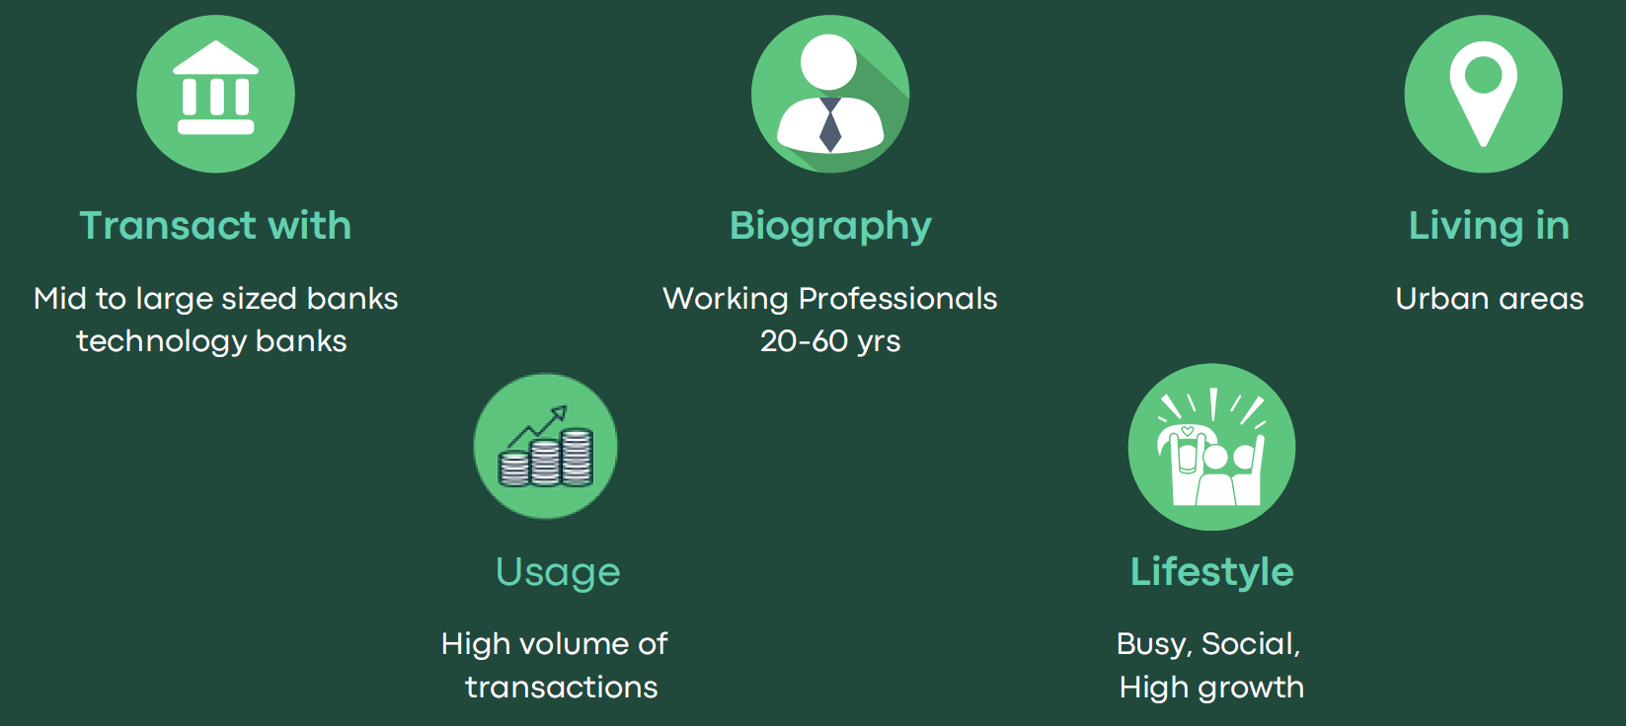
User Segment
Retail banking customers with below characteristics would be early adopters of our solution

Slide 5
Pain Points
Functional:
Time to review one’s account activities routinely
Time taken to track refunds till received
Insufficient information ascertain genuineness of transactions
Lack of knowledge to understand information on the statement
Emotional:
Feeling anxiety when unable to recollect or understand transactions.
Feeling monetary loss due to late discovery of any debits.
Feeling angered, sad, or ashamed when face a loss

Slide 6
Pre-Requisite
Alternatives / Competitive products
No alternatives that provide insights on accounts held at different institutions
No alternatives that provide insights on accounts for different account types such as savings, checking, credit card on one platform.
Notifications from account servicing FIs for some of the transaction types but these are not insights but just transaction alerts and tend to get overlooked.
Existing alternatives have limitations.

Slide 7
Tools or resources
Probable tools and resources needed:
Cloud Platform: Microsoft Azure
Programming Language: Java/Python/Angular
Database: Azure SQL Database/Cosmo DB
Software Development Tool: Visual Studio Code
Security Tools: Azure Active Directory & Azure Information Protection
Networking Tool: Application Gateway

Slide 8
Supporting Functional Documents
Solution
A mobile application called Account Insights that would let customers configure
transactions of concern such as duplicate transactions, refunds etc.
on their checking / savings accounts as well as credit cards accounts
held with different banks.
With the help of open APIs, the application would then automatically –
scan the customer accounts at configured intervals and
notify customers as it finds any of these transactions of their interest
Benefit:
save customers from tracking such transactions manually, and
leave them time to pursue more productive activities of their interest.

Slide 9
Supporting Functional Documents
Methodology
We carried out the following activities [supporting artefacts provided in appendix]
User Research via Customer interviews and other secondary research
User Personas
Empathy Maps
Brain storming and Affinity mapping of features
Core user stories
User scenarios

Slide 10
Supporting Functional Documents
Key technical aspects
Multi-factor Authentication: Multifactor Authentication is a security mechanism that requires user to provide two or more forms of authentication to access a system or application. This can be achieved through user identification, first-factor authentication, second-factor authentication, authorization and user education. Azure’s Active Directory provides the benfites of the users by providing multifactor authentication with 99.99% cybersecurity attacks free access in a single sign-on
Security & Scalability: Implementing security in a banking app is crucial to ensure the protection of sensitive data and prevent unauthorized access. This can be achieved through strong authentication, encryption, secure network, authorization, user activity monitoring, regular updates and patches, and compliance with regulations. Here’s where the Azure’s best security and network tools come in. Tools such as Azure Information Protection(Protects user’s information) and Application Gateway(Secures, scalable & highly available web front ends)
Multi-class Classification Algorithm[Machine Learning]: Multi-class classification is a supervised learning problem where the goal is to classify input data into one of several mutually exculsive categories or classes. In this type of problem, the input data can be represented as a set of features, and the other or label is a categorical variable with multiple possible value (E.g., Refunds, Duplicate Transactions, Automatic Montly/Yearly Deductions, etc).

Slide 11
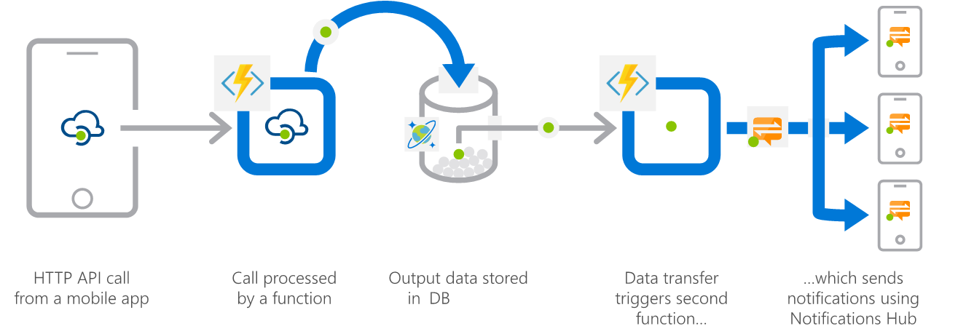
Supporting Functional Documents
Architecture

Slide 12
Key Differentiators of Solution
Automated review of account statements
Automated alerting of doubtful and other transactions of concern
Review of accounts held with different servicing institutions at one place
Review for any account types such as demand deposit accounts, credit cards, insurance, utility service providers
Configurable periodicity of notifications
Background processing and notification - no user-initiated action required

Slide 13
Adoption Plan
Presented a prototype to customers and asked them if they would find it worthy and if they would hire it to get their job done.
Feedback was encouraging; they found automated solution to be useful.
Exercise with users to know a important features that the product ought to provide.
From the above, an independent B2C mobile application in the Fintech space that also provides other digital payment services in addition to the mentioned features.

Slide 14
GitHub Repository Link
https://github.com/AkankshaP03/Restless-Rockets

Slide 15
Supporting diagrams / aretefacts
User Research – Key Interview Questions
Which bank do you transact with the most? What transactions do you usually do, and using what modes? How do you oversee the activity in your account with that bank?
What are your reasons for monitoring the activity in your account?
Upon reviewing your account’s activity have you found any issues that validate your reasons for monitoring your account or otherwise?
How do you feel about the way you currently oversee your account? Have you come across anything that would let you oversee your account in an automated way?
1
2
3
4

Slide 16
Supporting diagrams / aretefacts
Key jobs to be done
Functional Jobs:
Checking if any doubtful or duplicate transactions on account
Checking if any automatic debits to account
Checking receipts of refunds
Checking sufficient account balance
Emotional Jobs:
Feeling assured of not being cheated
Social Jobs:
Being able to fulfill needs and aspirations of dependents
Being known and seen as a person managing finances well

Slide 17
Supporting diagrams / aretefacts
Key customer insights
Customers review their account activity to keep a track of their spending and their account balance.
They also do so out of anxiety of losing their money to fraudulent transactions or any system issues.
They have had instances of duplicate debits, tracking refunds to their accounts.
They have had to intervene and do follow-ups at times and have had to monitor their account till the refund was received.
During such incidents, they went through difficult emotions such as irritation, anger, frustration, and distrust towards the system, their account relationships.
They say tracking account statements is necessary but also time taking.
Having the time and discipline to review these routinely is a challenge to many.

Slide 18
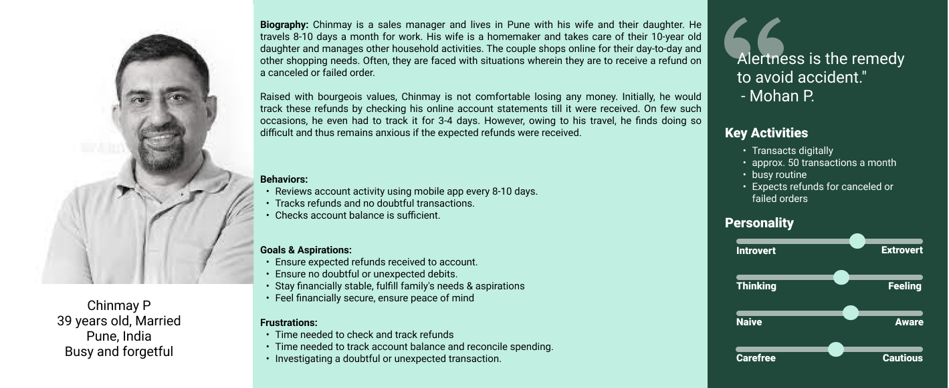
Supporting diagrams / aretefacts
User Persona

Slide 19
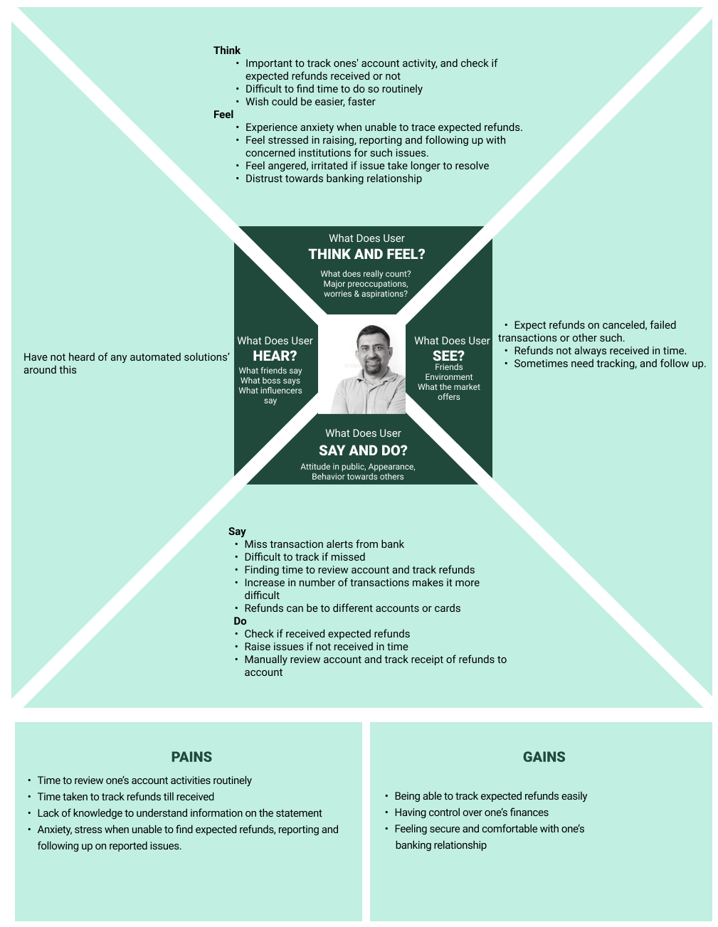
Supporting diagrams / aretefacts
Empathy Map

Slide 20
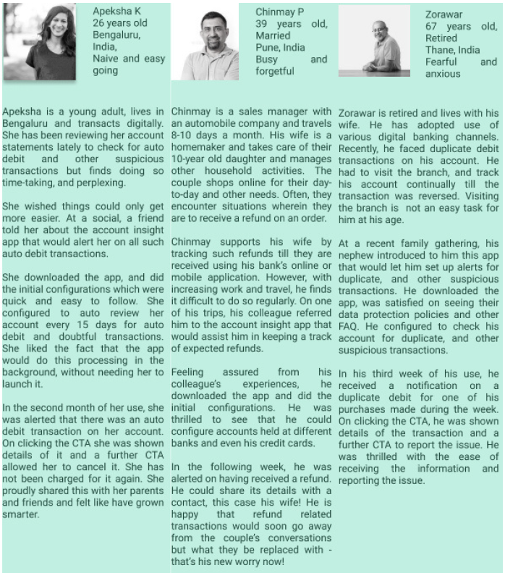
Supporting diagrams / aretefacts
User Scenarios

Slide 21
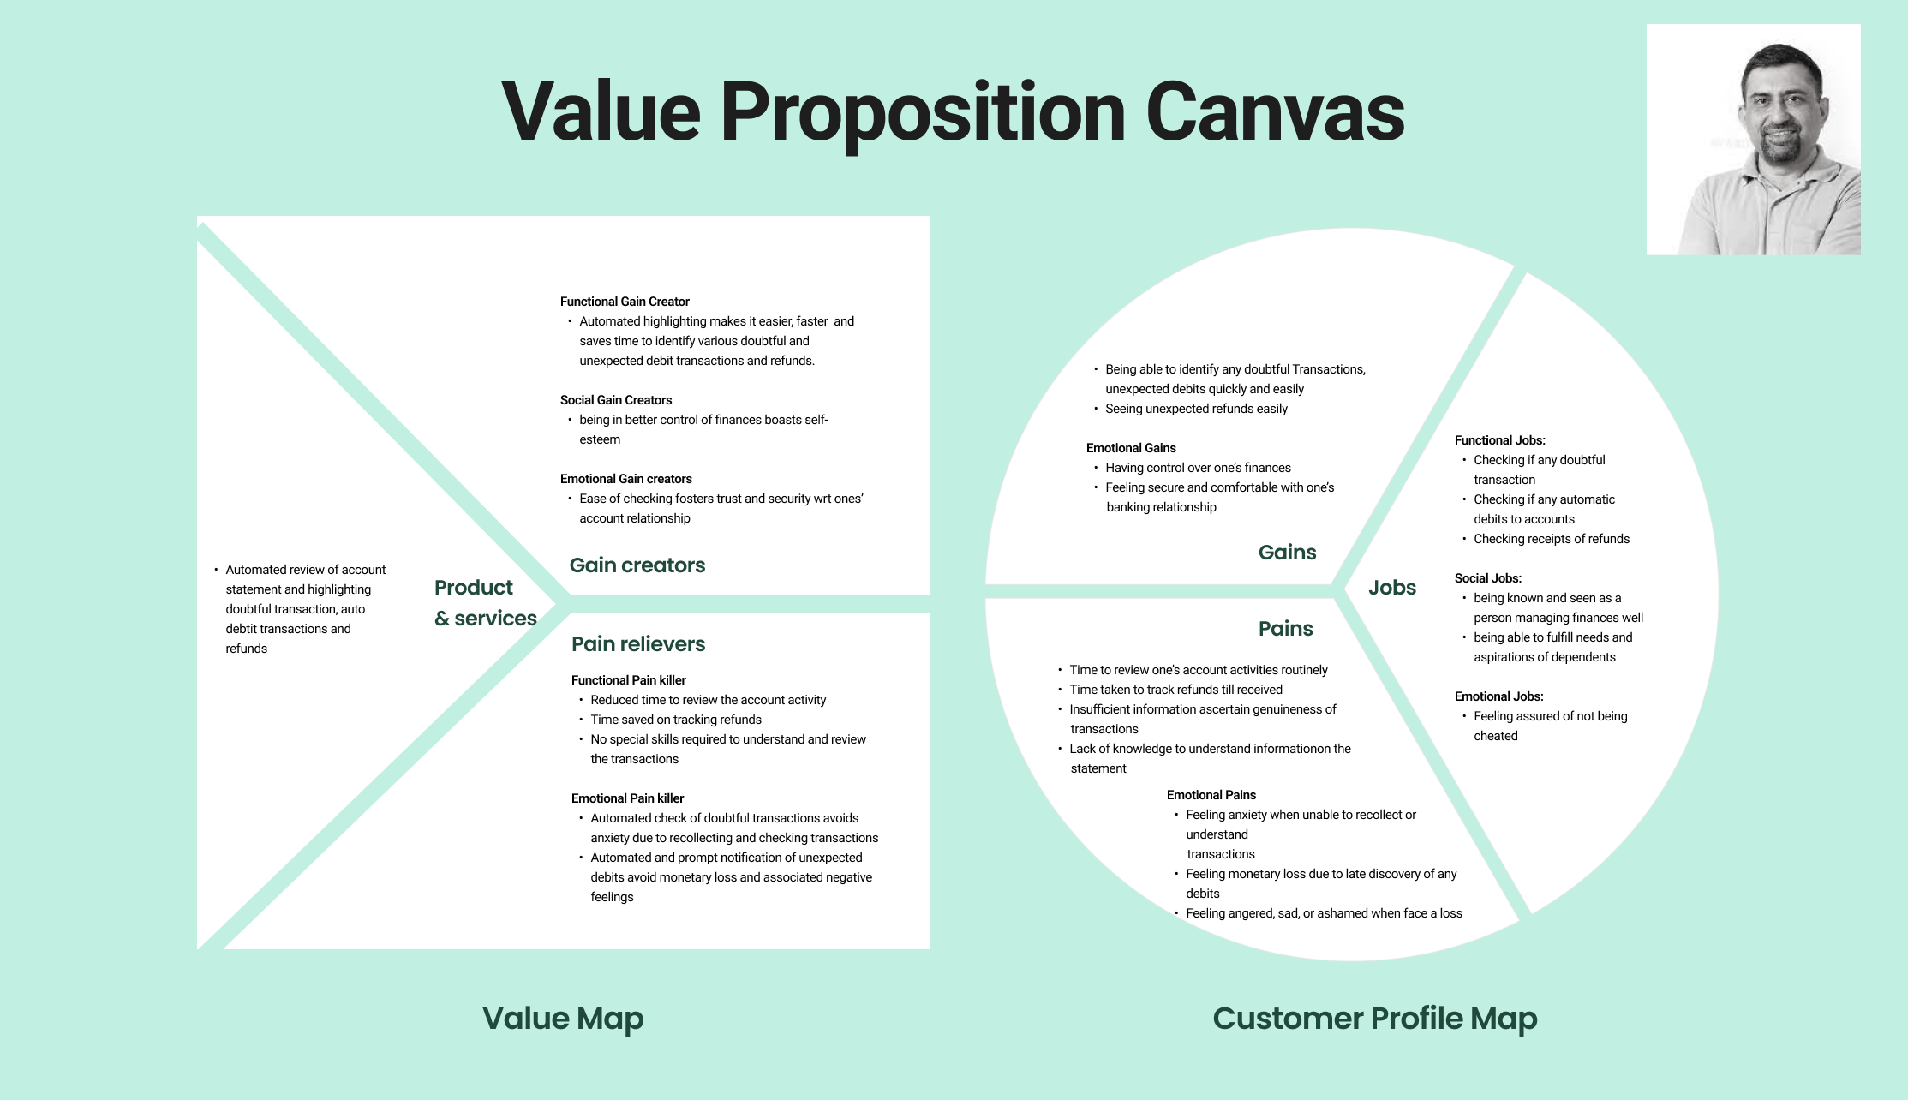
Supporting diagrams / aretefacts
Value Proposition Canvas

Slide 22
Thank You
Amit Shah
Akanksha P
Vishwajit Sorti
Vijay Umale

